Slide 1




Nymph: Open Minded Dating App
G1-GRUPA 3
Qinshift: The shift begins with you!
Nymph
HTTPS://WWW.NYMPH.SO/
HTTPS://WWW.SEDC.MK/

Slide 2
“Testing is to Software as Experiment is to Science”
A test / examination as evaluation/ - we detect it as measure of knowledge, skill, or classification in many other topics,
verbally, on paper or on computer, for the things that we have to know.
The evolution of testing was to make the exam process more convenient and comfortable
while still protecting the integrity of our certifications.
The goal is to assure that the changes have not unintended consequences on the behavior of the test object.
QA teams have a series of test cases for important features that they will re-execute each time these code changes occur
to save time and maximize test efficiency. If the project does not have a version control system,
it can be tricky to locate the exact component that produces the bug. With testing, we know exactly
where the bug comes from,
enabling better troubleshooting. It is essentially a periodic health check-up for the software.
Manual testing is a type of software testing where testers evaluate software or application quality manually,
without the help of automated testing tools or executing test scripts.

Slide 3
Mobile testing, or mobile app testing, is the process of checking and validating all aspects of the mobile app to ensure
that they work as expected. Any issues and defects found during the process are reported to the dev team to address immediately so that they will not slip into production.
Human testers interact with the application manually just as an end-user would to check if the application delivers
the expected functionality and performance.
They don’t rely on help from any automated scripts or tools, but solely use their human capabilities to find bugs.
Mobile App Testing involves analyzing mobile apps for functionality, usability, visual appeal,
and consistency across multiple mobile devices. It helps ensure an optimal user experience,
irrespective of the device used to access the app.
The purpose of mobile application testing is to get initial results of the functioning of the first version.
Results were obtained which contain certain errors (bugs) and which should be corrected during the creation
of the mobile application.

Slide 4
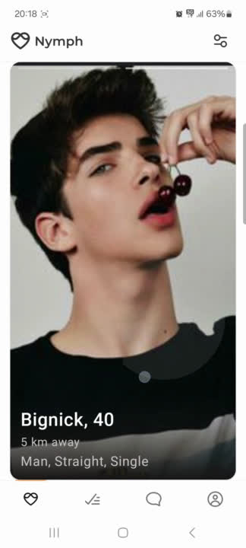
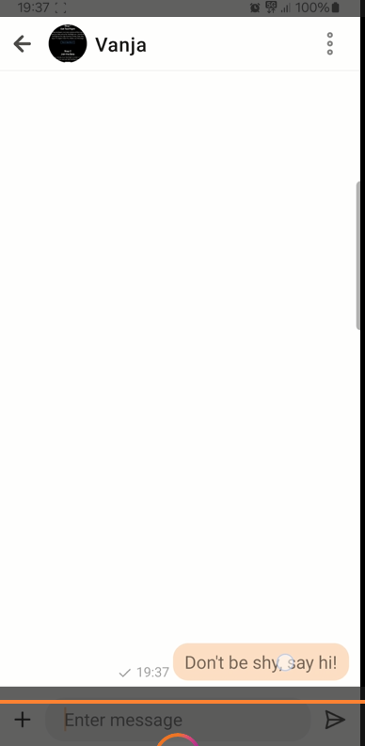
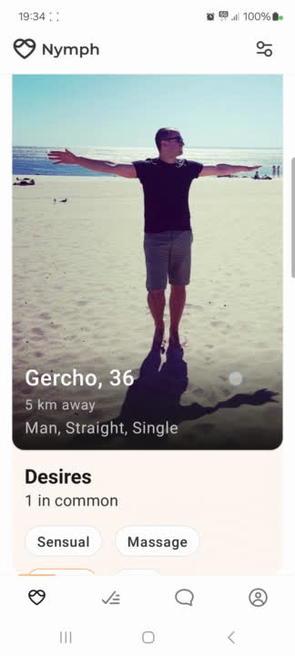
BUG REPORT ID: 01
Summary - No. 01 - Copying text -
User can check if there is option for coppying text
Description - When trying to copy text from
the same or another message, there is no option
Steps to reproduce:
1.Open the application.
2.Sign in with your phone number.
3.Navigate to the home page.
4.Choose one profile and scroll down.
5.Click on ‘Match’.
6.Click ‘Write a message’.
7.Try to copy a message text
Expected Results:
There should be an option for copying the text message.
Actual Results:
No options for copying message
and no Pop Up message “No such an option”

Slide 5
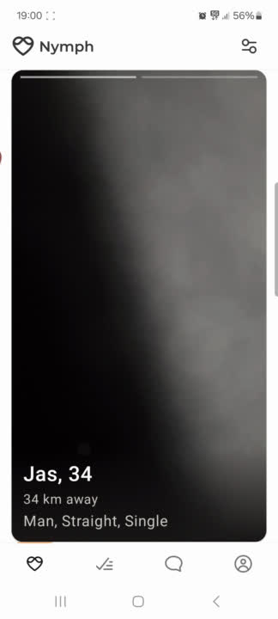
BUG REPORT ID: 02
Summary - No. 2 - User can see the display of all existing members
Description - When trying to list all of existing members, they are dissapearing for another search
Steps to reproduce:
1.Open the application.
2.Sign in with your phone number.
3.Navigate to the home page.
4.List the profiles.
5.Exit the home page.
6.Return on the home page
7.No options to list the existing members again
Expected Results:
There should be an option for listing the members again
Actual Results:
No options for listing active members again

Slide 6
BUG REPORT ID: 03
Summary - No. 3 - User is clicking on people to match
Description - User can not find the people after clicking on match
Steps to reproduce:
1.Open the application.
2.Sign in with your phone number.
3.Navigate to the home page.
4.List the profiles.
5.Click on some profile for match
6. Exit from the home page
6.Navigate to the match page
7.No options to list the matching members
Expected Results:
There should be an option for seeing the members again
Actual Results:
No options for listing matching profile

Slide 7
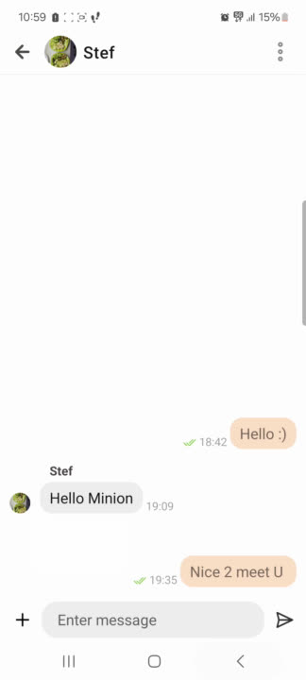
BUG REPORT ID: 04
Summary - No. 3 - User is clicking on block and report
Description - User can not report for the fake profile, underage or another option
Steps to reproduce:
1.Open the application.
2.Sign in with your phone number.
3.Navigate to the home page.
4.List the profiles.
5.Click on some profile for block
6. Click to report and write a feedback
6.Click on submit button
7. There is a pop up message “Something went wrong”
Expected Results:
There should be an option for submitting a feedback
Actual Results:
No options forsubmitting the feedback

Slide 8
BUG REPORT ID: 05
Crash on Get Started and Sign in
Steps to Reproduce:
1. Open the application.
2. Click Get started or Sign in and enter your phone number
3. Then enter the verification code that application sends you in message on your phone
4. Tap on the ">” to proceed.
Expected behavior :The application should successfully log in and transition to the main dashboard. Actual result:The application crashes after you enter the verification code that was send in message and says “invalid verification code” but the code that you entered is identical with the code in the message. Additional Notes:
This kind of crashes happens to be very frequent when you click on Get started or Sign in, if you try to Login or Sign in 10 times for example, 7 times of 10 Application crashes. Reproducibility:
• 70%
ON THE NEXT TWO SLIDES THERE ARE SCREENSHOTS WHERE YOU CAN SEE WHAT THIS BUG ABOUT

Slide 9
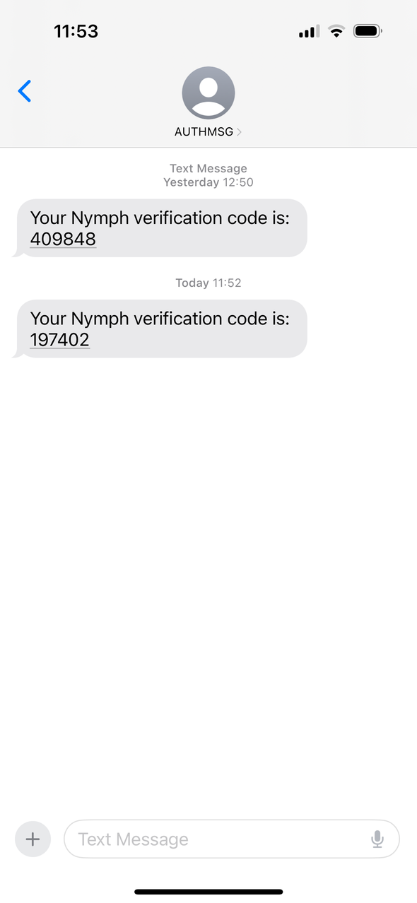
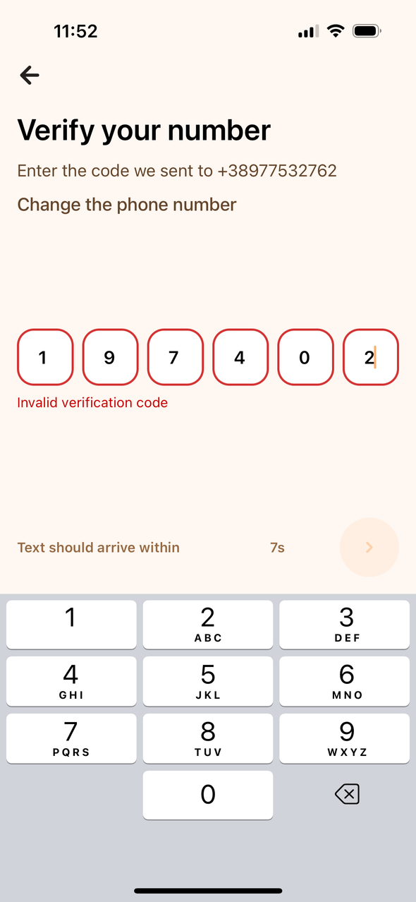

Slide 10
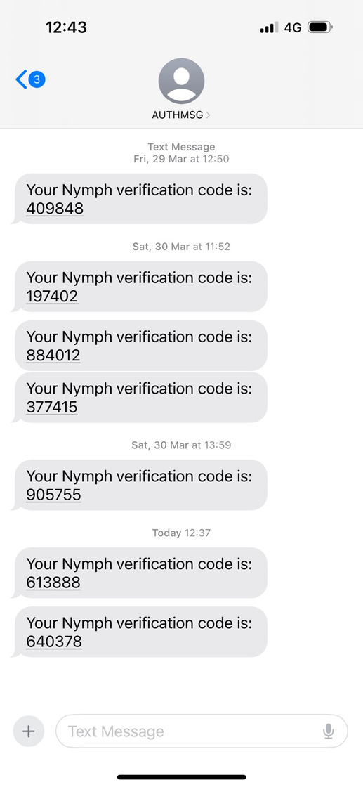
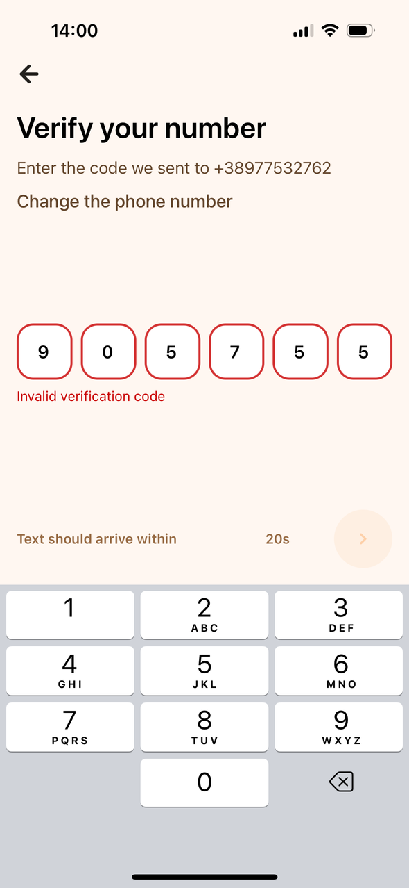
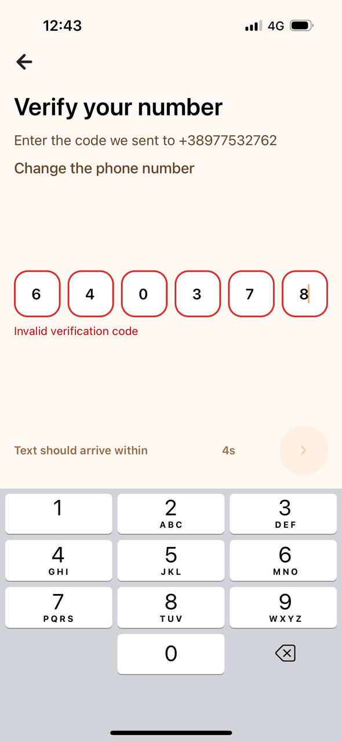

Slide 11
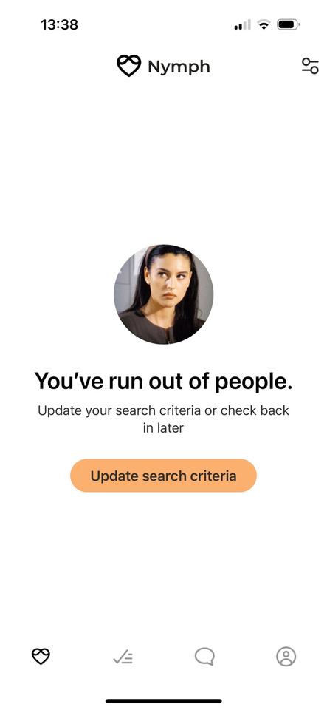
BUG REPORT ID: 06
There is no search field
Steps to Reproduce:
1. Open the application.
2. Click Get started or Sign in and enter your phone number
3. Then enter the verification code that application sends you in message on your phone
4. Tap on the ">” to proceed.
Expected Behavior:
• The application should allow you to find people that you want and search them by the name of their profile.
Actual results:
• If you have profiles that matches your interests they are showing and you can scroll, after you scrolled profiles that are showing on the main page than application shows message “You’ve run out of people”.
• The application shows a message “You’ve run out of people”, and there is no search field. Additional Notes:
Application should upgrade and have “Search” option like one of the main tool to work properly and easier. Reproducibility:
• 100%

Slide 12
BUG REPORT ID: 07
Application runs out of profiles
Steps to Reproduce:
1. Open the application.
2. Click Get started or Sign in and enter your phone number
3. Then enter the verification code that application sends you in message on your phone
4. Tap on the ">” to proceed.
5. If you have profiles that matches your interests they are showing and you can scroll, after you scrolled profiles that are showing on the main page than application shows message “You’ve run out of people”.
Expected Behavior:
•The application should allow you to scroll profiles that are showing on the main page over and over, and not disappearing after the first scroll.
Actual results:
• The application shows a message “You’ve run out of people”, and there is no option for further scrolling.
Additional Notes:
1. This bug report is closely related with bug report of the search field, because application does not allow you to scroll over and over and not allowing you to see if you can have some matches after scrolling 2, 3 or multiple times, instead you’ve run out of profiles if you not press "like" to some profile on the first view and have no other option, neither scrolling or searching for profiles, application should upgrade on this for the opportunity of the further usability. Reproducibility:
• 100%

Slide 13
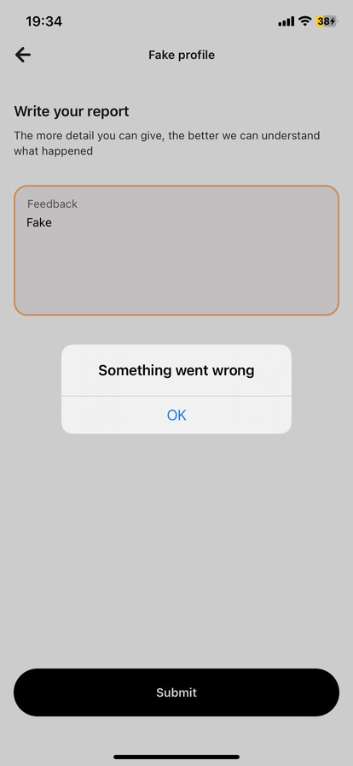
BUG REPORT ID: 08
User can not block/report a profile as fake
Steps to reproduce:
1.Open the application.
2.Sign in with your phone number.
3.Navigate to the home page.
4.Choose oneprofile and scroll down.
5.Click on ‘Hide and Report’.
6.Click ‘Fake Profile’.
7.Write Feedback : ‘This is fake profile’.
8.Click Submit.
Expected Results:
There shuld be a pop up message “You’ve blocked and reported this profile’.
Actual Results:
Application crashes.

Slide 14
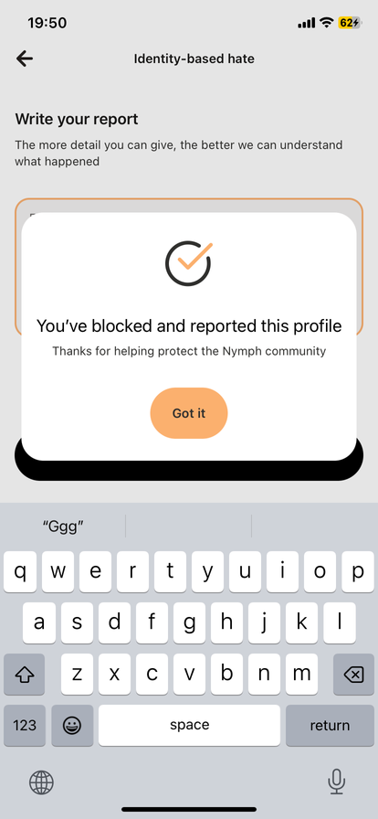
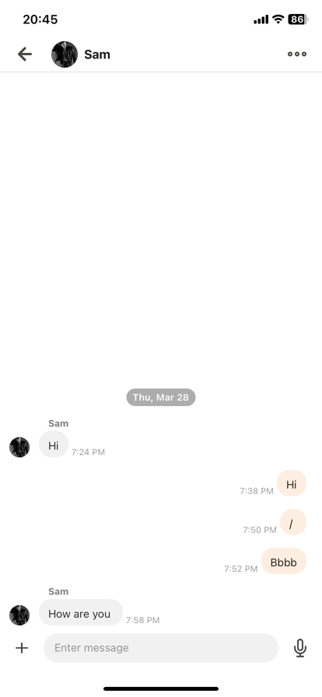
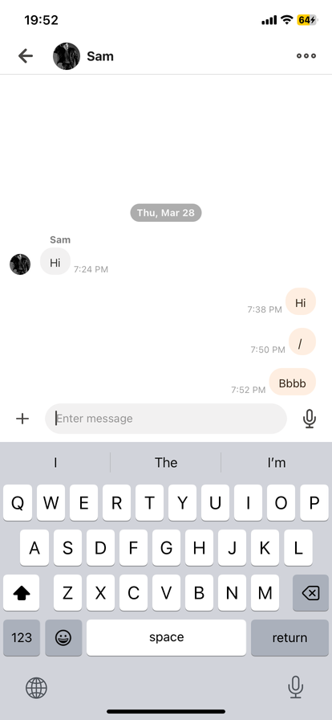
BUG REPORT ID: 09
User can message me after blocking
Steps to reproduce:
1.Open the application.
2.Sign in with your phone number.
3.Navigate to the messages page.
4.Click on one profile and message them.
5.Click on the chat options button.
6.Click ‘Block and Report’.
7.Click ‘Identity-based hate’
8.Write feedback.
9.Click ‘Submit’.
10.Navigate back to the same chat.
11.Send new message.
Expected Results:
There shuld be a pop up message “You’ve blocked and reported this profile’.
Actual Results:
User can message me after blocking, so can i.

Slide 15
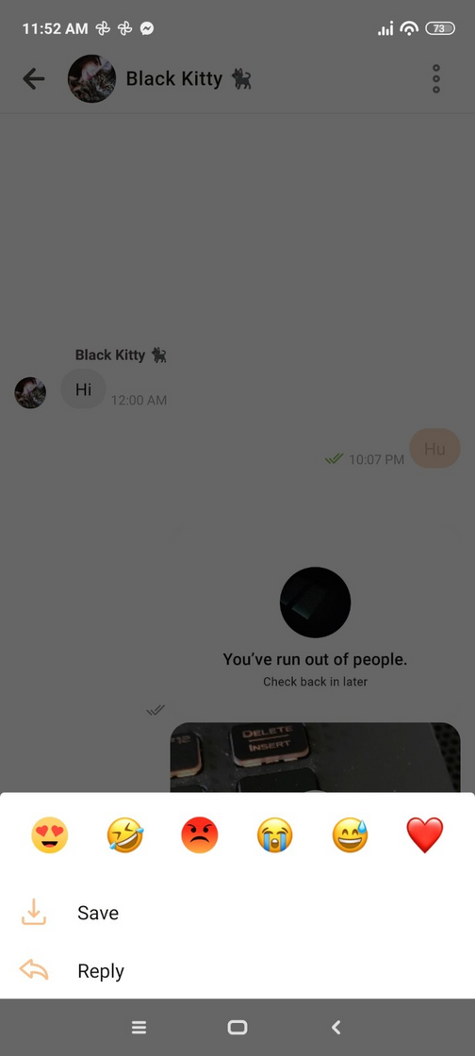
BUG REPORT ID:10
User can’t delete photos or videos that are already sent
1.Open the chat
2. Send photo or video
3.When the photo or video is selected there is no option to remove it
Expected result: There should be option to delete
Actual result: Only options are save and reply

Slide 16
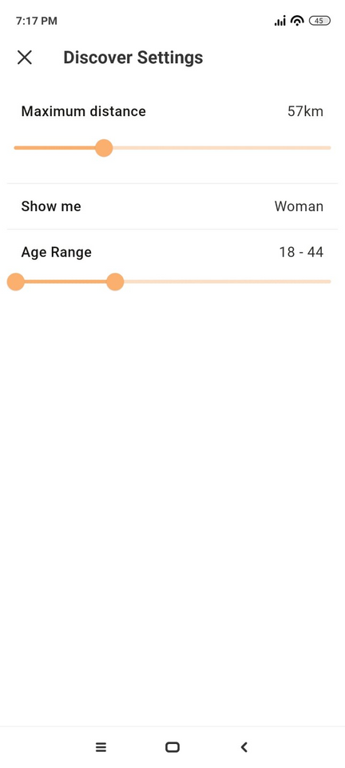
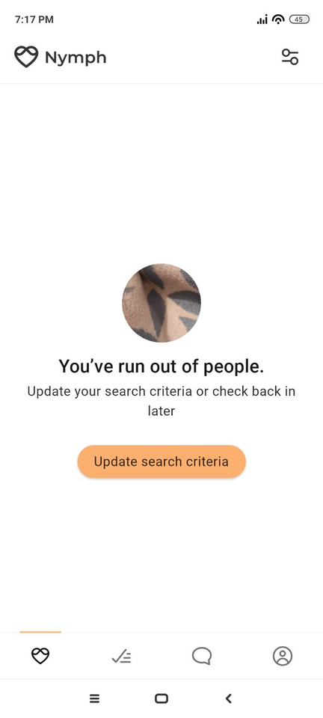
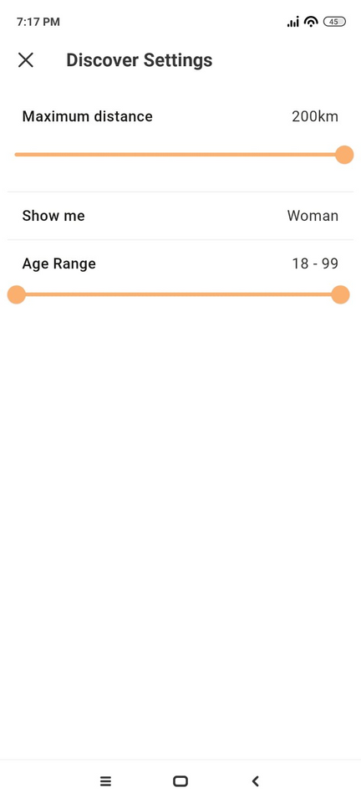

BUG REPORT ID: 11
1.The App navigates the user to update search criteria
2.After max distance and Age Range are changed
3.On the main page again is shown the same message to Update the search criteria

Slide 17
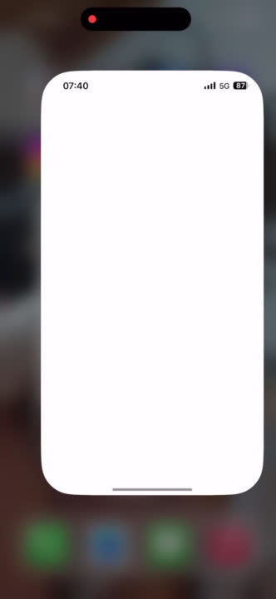
Bug report ID 12
Application crash when open chat
Steps to reproduce
Open the app, go to the chat
Click on the deleted match friend
and
application will crash when u try to load previus chat history

Slide 18
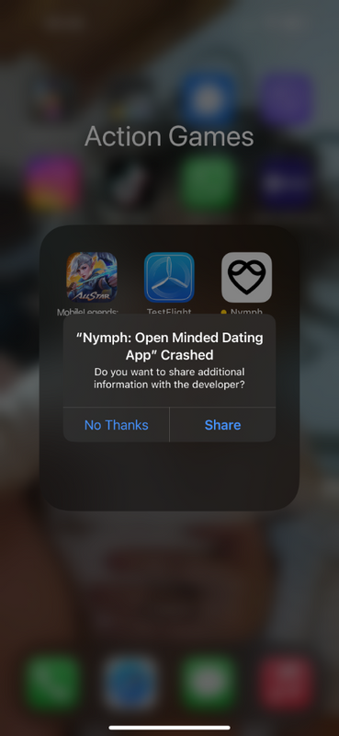
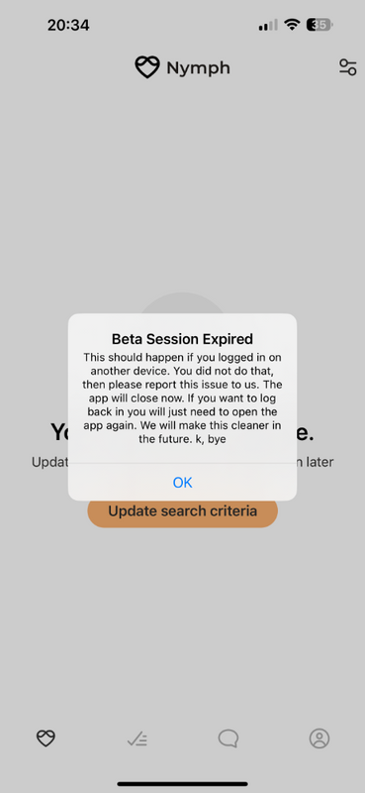
Bug Report ID 13
Logout crash the app
How to reproduce the bug
Open the app and go to the logout button
click on the logout button and its write beta sesion expired
when clock on the OK button its crashed the application

Slide 19
Based on user feedback and the experience we had testing the NYMPH app, we believe that the application should focus first on missing features that we, as QA engineers, believe are essential. We also believe that the application should prioritize making the app easier to use in order to ensure its long-term viability given the fierce competition among dating apps.
Apart from certain functionalities that would be good to add, we believe that the presented bugs that we saw in this presentation would also be of great importance if we worked on them and fixed them because they prevent the normal functioning of the application.
It is our goal that the program will be successfully used by taking into account and accepting our suggestions.

Slide 20

Thank You
FANKA SHUNDOVSKA
SNEZHANA TACHEVSKA
NATASHA ANTOVSKA
MARTIN STOJANOVSKI
NIKOLA POPOVSKI

